Slide 1

END SEM PRESENTATION
on
SARCASM DETECTION USING COMBINED BERT AND GCN
Team Members
B.SAI ABHISHEK BL.EN.U4AIE21015
B.RUCHITH BALAJI BL.EN.U4AIE21017
CHILLAKURU HARI BL.EN.U4AIE21038
Date:27/05/24
Course :MIS 6
Murali Sir
AI 6th Sem –E Sec

Slide 2
CONTENTS
Introduction
Problem Statement
Dataset Description
Proposed Methodology
Results
Conclusion
References

Slide 3
INTRODUCTION
Sarcasm detection in text is crucial for accurate sentiment analysis and social media understanding.
Detecting sarcasm is crucial for accurate interpretation of text, as failing to recognize it can lead to misinterpretation or misclassification of sentiment.
This project proposes a novel approach for sarcasm detection using a combined BERT and GCN architecture.
The fusion of BERT and GCN enhances sarcasm detection accuracy by leveraging their complementary strengths.

Slide 4
INTRODUCTION
The proposed approach contributes to advancing the state-of-the-art in sarcasm detection, offering insights into the effective integration of deep learning techniques for linguistic analysis.
The fusion of BERT and GCN offers a complementary framework for sarcasm detection, leveraging BERT's contextual embeddings alongside GCN's ability to capture syntactic and relational dependencies.

Slide 5
Problem Statement
The problem Statement is to combine BERT and GCN to detect Sarcasm for the given text.
The goal is to build a scalable and efficient solution that incorporates advanced deep learning techniques to predict with High Accuracy
Challenges:
Data Collection.
Creating a combined deep learning Model.
Training the model to get high Accuracy.
Comparing the trained models.

Slide 6
LITERATURE REVIEW
Title: Sarcasm Detection Using Deep Learning With Contextual Features
Authors: MD SAIFULLAH RAZALI, ALFIAN ABDUL HALIN ,LEI YE
This paper was published in 2021.
This work focuses on detecting sarcasm in tweets using deep learning extracted features combined with contextual handcrafted features. A feature set is extracted from a Convolutional Neural Network (CNN) architecture before it is combined with carefully handcrafted feature sets. These handcrafted feature sets are created based on their respective contextual explanations.

Slide 7
LITERATURE REVIEW
Title: A Machine Learning Approach for Detecting Intended Sarcasm using Oversampling.
Authors: Ajayan, A.K., Mohanan, K., Anugraha, S., Premjith, B. and Kp, S
This paper was published in 2022.
The paper presents a classification problem which allows to detect sarcasm by using machine learning algorithms such as K-Nearest Neighbor, SVM, NB, Decision Tree, Logistic Regression, Random Forest ensemble to identify class imbalance issues.

Slide 8
Research gap
In the base paper they have used LR as the main architechture to detect the sarcasm from the given text.
The results they got, accuracy is 94%
Now we are using Combined BERT+GCN to detect the sarcasm from the text data.
We got accuracy as 99.28 % on the test data.

Slide 9
Data Set Description
Corpus | Train Set |  | Test Set
 | Sarcastic | Non-Sarcastic | Sarcastic | Non-sarcastic
riloff | 215 | 1,153 | 93 | 495
headlines | 2516 | 2504 | 570 | 410
Description:
The data set is of TEXT data.
It consists of 3300 Sarcastic and 4100 Non – Sarcastic sentences.
Dataset is divided into train and test sets.

Slide 10
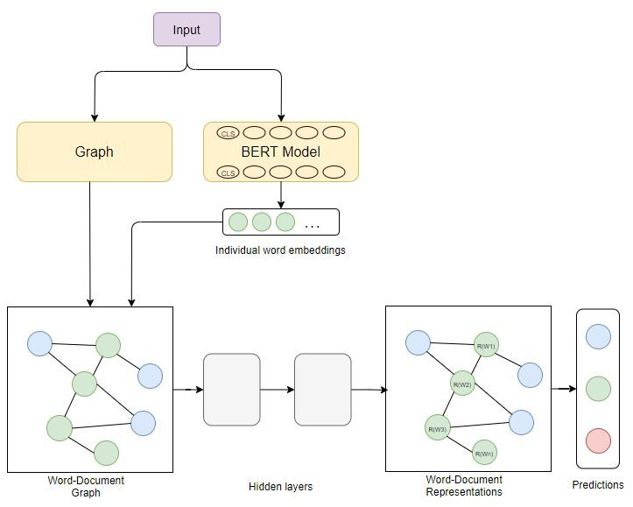
Methodology – Architecture

Slide 11
Word Embedding
It captures both the semantic meaning of words and their context within a sentence.
It is a step done in pre-processing like adding some special tokens like [‘cls’] and [‘sep’].
Convert the tokens to their corresponding IDs.
It passes these encoded data to word-document graph.

Slide 12
Word-Document Graph : The graph G=(V,E) is constructed where V are the nodes and E are the edges.
Hidden Layers : Introduce Non-Linear Transformations to input features , enable the model to learn complex mappings between the input and output .
Hidden layers also helps in preventing overfitting which is commonly known as regularization using dropout.

Slide 13
Methodology - Overview
Data Collection: This is the first step in the methodology. It involves collecting the text data that will be processed.
Pre-processing: This step involves cleaning and preparing the text data for further processing. It includes the following sub-steps:
Tokenization: This process breaks down the text data into individual words or tokens.
Stop Word Removal: This step removes stop words, which are common words that don't carry much meaning, from the text data. For example, the words "the" "and" and "a" are all stop words.
Stemming: This process reduces words to their base stem. For example, the word "running" would be stemmed to "run".
Lemantization: This process reduces words to their dictionary form, also known as a lemma. For example, the word "running" would be lemmatized to "run".

Slide 14
Methodology - Overview
Construct GCN Graph: This step creates a graph representation of the text data.Graph Processing: This step involves processing the graph to extract features from the text data.
BERT Encoding: This step uses the BERT model to encode the text data. BERT is a pre-trained transformer model that can be used for a variety of natural language processing tasks, such as text classification and question answering.
Feature Extraction: This step extracts features from the encoded text data.
Classification Algorithm: This step uses a classification algorithm to classify the text data.
Evaluating: This is the final step in the methodology. It involves evaluating the performance of the classification algorithm.

Slide 15
Methodology – Flow Diagram
Tokenization
Stemming
Construct Graph
GCN Processing
Data Collection
Pre Processing
BERT Encoding
Feature Extraction
Classification Algorithm
Evaluating
Stop Word Removal
Lemmantisation

Slide 16
Results
Model | Accuracy | Precision | Recall | F1-Score
BERT+GCN | 99.28 | 96.57 | 95.89 | 90.33
Model | Loss | Val Accuracy | Val F1-Score | Val Loss
BERT+GCN | 0.0297 | 97.57 | 85.11 | 0.025
Description:
Accuracy - 99.28
Precision - 96.57
Recall - 95.89
F1 – Score – 87.85

Slide 17
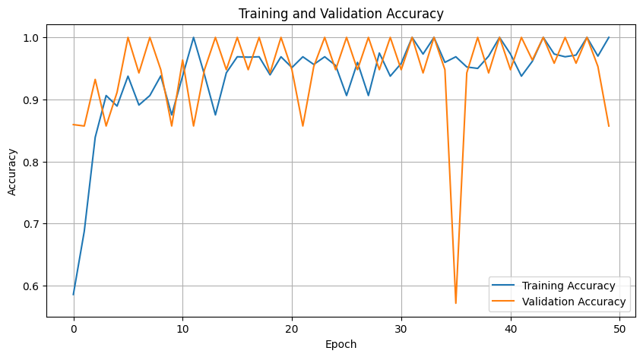
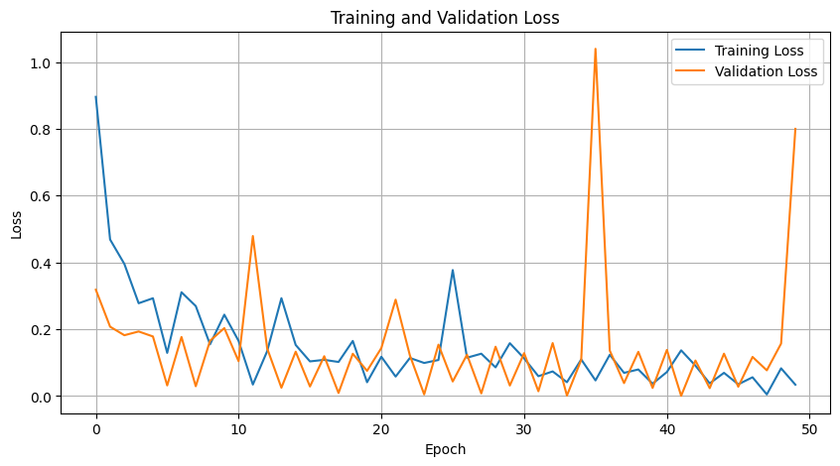
Results
Validation Accuracy and Training Accuracy Obtained for 50 Epochs
Validation Loss and Training Loss Obtained for 50 Epochs

Slide 18
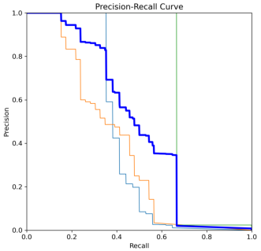
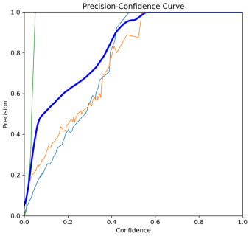
Results
Precision Recall Curve
Precision confidence Curve

Slide 19
Conclusion
Unlike other methods in literature , the BERT+GCN model exhibits a improved performance in the field of sarcasm detection, as analyzed by the results of the training and validation with high ability metrics.

Slide 20
References
Sreelakshmi, K., Premjith, B., Chakravarthi, B.R. and Soman, K.P., 2024. Detection of Hate Speech and Offensive Language CodeMix Text in Dravidian Languages using Cost-Sensitive Learning Approach. IEEE Access.
Venkatesh, B. and Vishwas, H.N., 2021, September. Real time sarcasm detection on twitter using ensemble methods. In 2021 Third International Conference on Inventive Research in Computing Applications (ICIRCA) (pp. 1292-1297). IEEE.
Kumar, R.P., Mohan, G.B., Kakarla, Y., Jayaprakash, S.L., Sindhu, K.G., Chaitanya, T.V.S.S., Ganesh, B. and Krishna, N.H., 2023, July. Sarcasm Detection in Telugu and Tamil: An Exploration of Machine Learning and Deep Neural Networks. In 2023 14th International Conference on Computing Communication and Networking Technologies (ICCCNT) (pp. 1-7). IEEE.
Bharti, S.K., Gupta, R.K., Shukla, P.K., Hatamleh, W.A., Tarazi, H. and Nuagah, S.J., 2022. Multimodal sarcasm detection: a deep learning approach. Wireless Communications and Mobile Computing, 2022, pp.1-10.

